Slide 1

An Automated COVID-19 SOPs Monitoring And Management System
GSN: FALL 21-18
Advisor: Mr. Hamza Yousuf
Client: Saleem Steel Industries
Presented by:
Maaheen Yasin (L18-1267)
Inbisat Mudassar Dar (L18-1283)
Ahmad Tameem Kamal (L18-1358)
Evaluation Committee:
Ms. Shazia Haque
Mr. Zeeshan Asif

Slide 2

Why Measure SpO2?
How SpO2 is measured using MAX30102?
Connections of MAX30102 with Arduino Uno
Demonstration
Remaining Tasks
CONTENTS

Slide 3

Why Measure SpO2 for COVID detection?
COVID-19 enters the body through the respiratory system, causing direct injury to a person’s lungs via inflammation and pneumonia.
Negatively impact how well oxygen is transferred into the bloodstream.
However, not everyone who tests positive for COVID-19 will develop low oxygen levels.

Slide 4
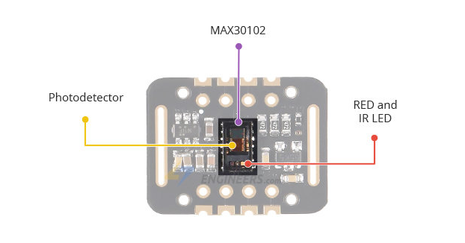
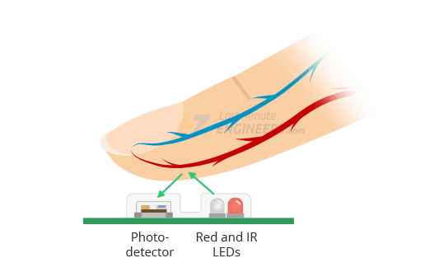
How SpO2 is measured using MAX30102?
consists of a pair of high-intensity LEDs (RED and IR, both of different wavelengths) and a photodetector.
Works by shining both lights onto the finger, both lights can easily penetrate the tissue and measure the amount of reflected light using a photodetector.

Slide 5
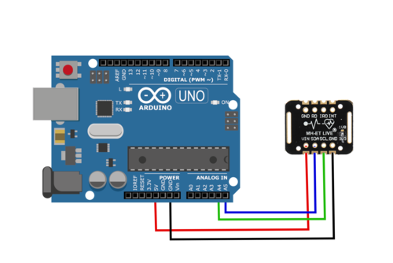
Connections of MAX30102 with Arduino Uno

Slide 6
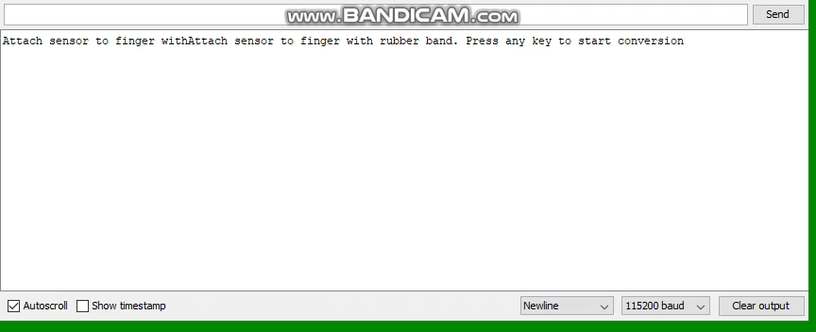
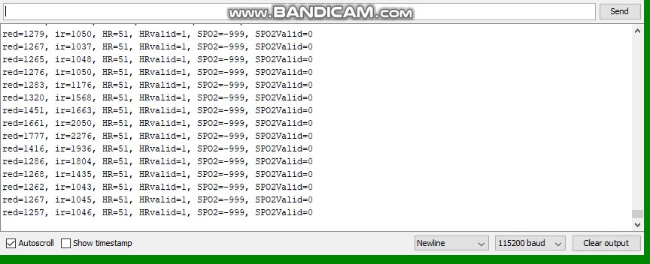
Demonstration

Slide 7
Remaining Tasks
Implementing Social Distancing Code using Jetson Nano (In Progress)
Integration of all four pieces of code
Adding Audio Assistance through speakers

Slide 8


